Slide 1
Sequential model

Slide 2
Attention is all you need

Slide 3
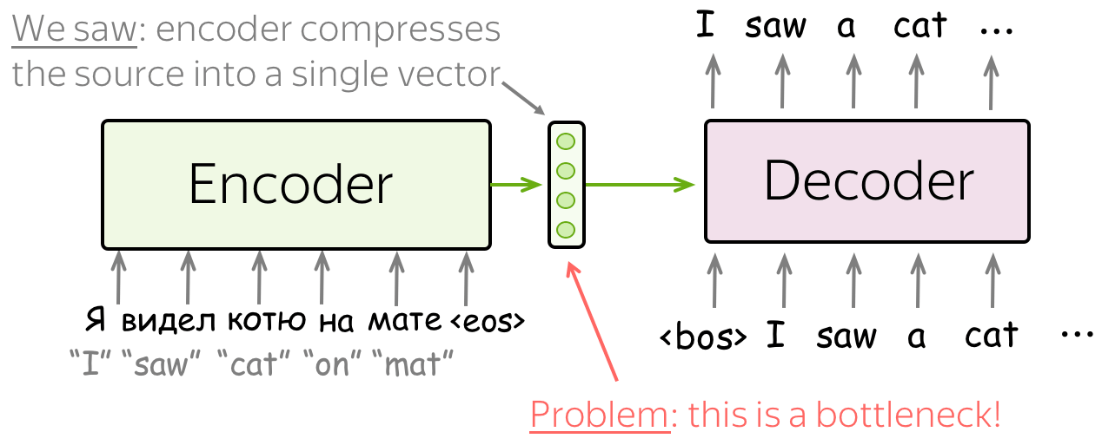
Problem with seq2seq
Notes:
https://jalammar.github.io/visualizing-neural-machine-translation-mechanics-of-seq2seq-models-with-attention/
https://towardsdatascience.com/classic-seq2seq-model-vs-seq2seq-model-with-attention-31527c77b28a
https://towardsdatascience.com/day-1-2-attention-seq2seq-models-65df3f49e263#:~:text=6%20min%20read-,Sequence%2Dto%2Dsequence%20(abrv.,in%20production%20in%20late%202016.d
https://lena-voita.github.io/nlp_course/seq2seq_and_attention.html

Slide 4
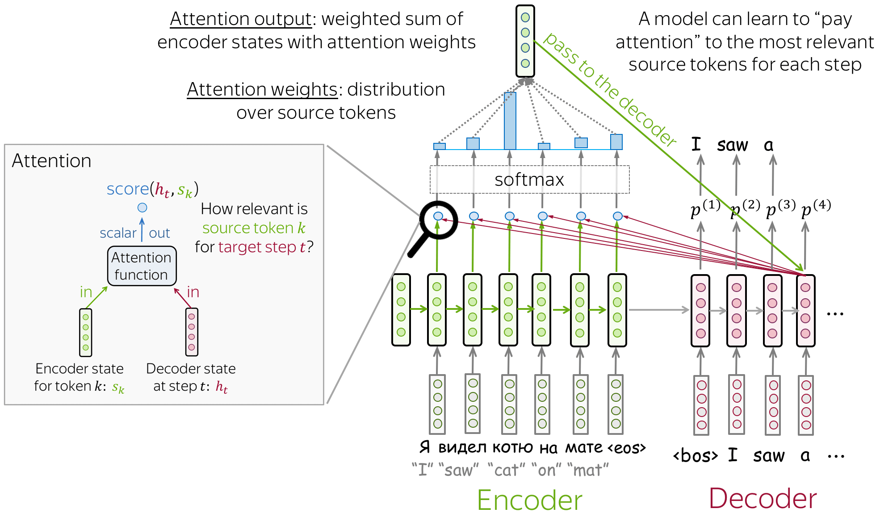
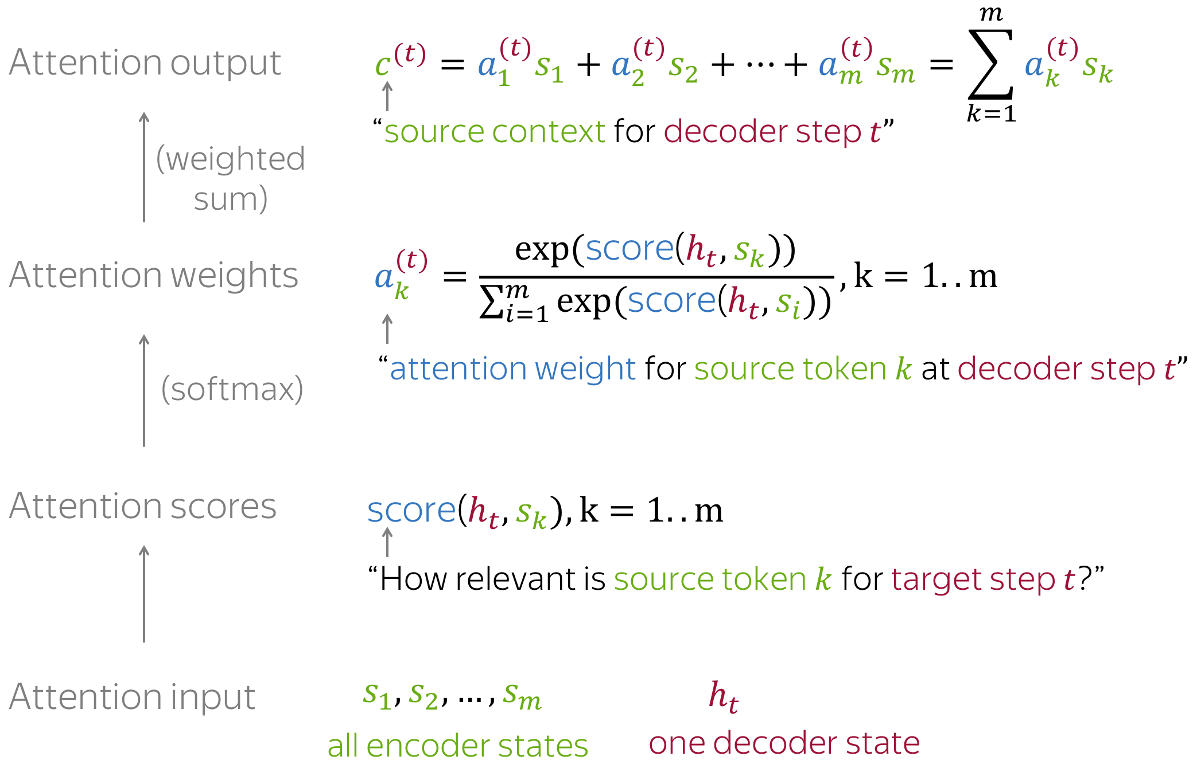
Attention

Slide 5
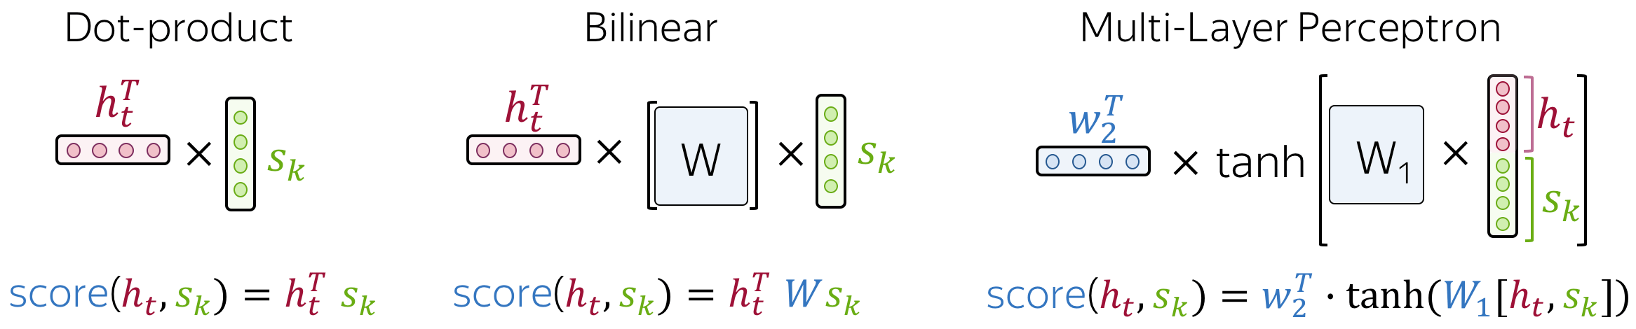
Attention score

